Slide 1
Intelligent Multi-Intent E-commerce Chatbot
Revolutionizing User Engagement with Advanced Conversational AI
Presented by : Neethu Manikantan

Slide 2
Presentation Agenda
Introduction: The E-commerce Challenge
Project Overview & Goals
System Architecture & Core Components
Multi-Intent Handling Explained
Key Features & Technical Deep Dive
Implementation Details & Workflow
Challenges & Solutions
Demo

Slide 3
The E-commerce Challenge: Why a Smart Chatbot?
Problem Statement:
Traditional e-commerce platforms often lead to user frustration due to information overload or difficulty finding specific products/answers.
High bounce rates, unaddressed FAQs, and inefficient customer support.
Need for personalized, instant assistance at scale.
Our Solution:
An AI-powered, multi-intent chatbot acting as a smart assistant.
Value Proposition:
Enhance user engagement, streamline information access, improve conversion rates.

Slide 4
Project Overview: Our Intelligent Chatbot
Primary Goal:
Develop a comprehensive conversational AI agent for e-commerce, capable of handling diverse user intents seamlessly.
Key Capabilities:
Answer FAQs
Perform dynamic product searches
Engage in casual conversation (small talk)
Distinguishing Factor:
Unified experience across multiple intents, leveraging cutting-edge LLMs and specialized databases.

Slide 5
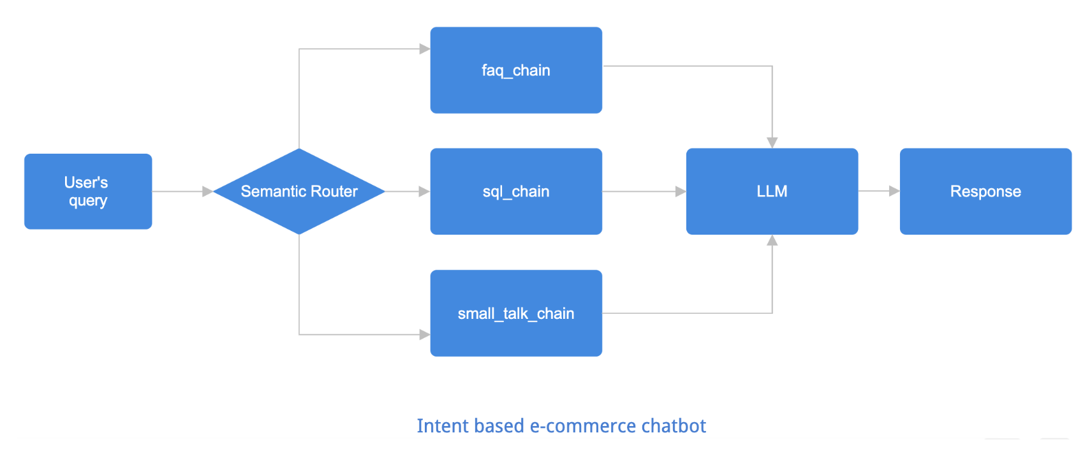
System Architecture: A High-Level View

Slide 6
Core Components: The Technology Stack
Groq LLM:
Leveraged for ultra-low-latency inference, crucial for real-time conversational responses.
Used for natural language understanding (NLU), generation (NLG), and response formatting across all intents.
Specific model used: Llama 3.3 (or specify exact version if known).
ChromaDB:
Vector database for storing and retrieving FAQ embeddings.
Enables efficient semantic search for RAG implementation.
Local persistence for knowledge base.
Streamlit:
Frontend framework for rapid prototyping and interactive UI development.
Provides a clean and intuitive chat interface for users.
SQLite:
Lightweight, serverless relational database for product catalog.
Chosen for ease of setup and dynamic SQL query execution.
Sentence Transformers:
Used for semantic routing and embedding user queries for intent classification

Slide 7
Multi-Intent Handling: The Core Logic
Concept: Seamlessly classifying user input into distinct intents (FAQ, SQL, Small Talk) to route to appropriate processing pipelines.
Mechanism: Semantic Routing:
User query is embedded using Sentence Transformers.
Compared against pre-defined intent embeddings (e.g., "policy questions," "show products," "greet me").
Cosine similarity (or other metric) determines the most probable intent.

Slide 8
Intent 1: FAQ Knowledge Base (RAG)
Process:
User asks an FAQ-related question.
Intent classifier identifies as 'FAQ'.
Query embedded and used to search ChromaDB for relevant document chunks (e.g., policies, general info).
Retrieved chunks are passed as context to Groq LLM.
Groq LLM generates a coherent and concise answer based on the provided context.
Benefits: Reduces hallucinations, provides factual answers, easily updatable knowledge base.

Slide 9
Intent 2: Dynamic SQL Product Search
Process:
User requests product information (e.g., "Show me all Nike shoes below Rs. 3000").
Intent classifier identifies as 'SQL'.
Groq LLM (or a specialized model/prompt) translates natural language into a valid SQL query.
The generated SQL query is executed on the SQLite database.
Results (e.g., product details, prices) are retrieved.
Groq LLM formats the database results into a user-friendly conversational response.
Challenges: SQL injection prevention, schema understanding by LLM, handling complex queries.

Slide 10
Intent 3: Casual Chat / Small Talk
Process:
User engages in general conversation (e.g., "How are you?", "Tell me a joke").
Intent classifier identifies as 'Small Talk'.
Query is directly passed to Groq LLM for general conversational response generation.
Purpose: Enhances user experience, makes the chatbot feel more "human" and approachable, improves engagement.

Slide 11
Implementation Details & Workflow
Setup:
Data Preparation (FAQs, Product Data for SQLite).
Embedding creation for ChromaDB.
LLM API key configuration.
Core Loop:
Receive user input via Streamlit.
Pre-process input (tokenization, lowercasing).
Perform intent classification.
Route to specific handler function (FAQ, SQL, Small Talk).
Execute logic within handler (DB query, RAG, direct LLM call).
Generate final response using LLM.
Display response in Streamlit UI.
Code Structure:
Modular (e.g., intent_classifier.py, faq_handler.py, sql_handler.py, app.py).

Slide 12
Challenges & Solutions
Challenge 1: Intent Overlap/Ambiguity:
Solution: Fine-tuning semantic routing with diverse training examples; adding a confidence threshold for classification; explicit clarification prompts.
Challenge 2: LLM Hallucinations (especially for RAG/SQL):
Solution: Strict adherence to retrieved context for RAG; robust validation of generated SQL queries; explicit grounding prompts for LLMs.
Challenge 3: Optimizing Latency:
Solution: Leveraging Groq's fast inference, efficient ChromaDB indexing, optimizing prompt engineering.
Challenge 4: SQL Injection Vulnerability:
Solution: Parameterized queries or careful sanitization of LLM-generated SQL; input validation before query execution.
Challenge 5: Scalability of Knowledge Base:
Solution: ChromaDB handles large vector stores; considering distributed databases for future scaling.

Slide 13
Demo
Streamlit Cloud Link - https://genai-e-commerce-chatbot.streamlit.app/

Slide 14
THANK YOU

